Slide 1
Binomial Coefficients
Rosen section 4.4
Prof Engr Faiz ul haque Zeya
From Aaron Bloomfield

Slide 2
Binomial Coefficients
It allows us to do a quick expansion of (x+y)^{n}
Why it’s really important:
It provides a good context to present proofs
  Especially combinatorial proofs

Slide 3
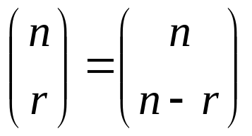
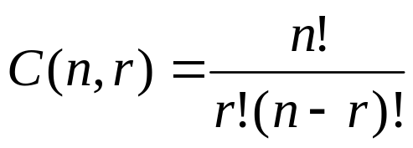
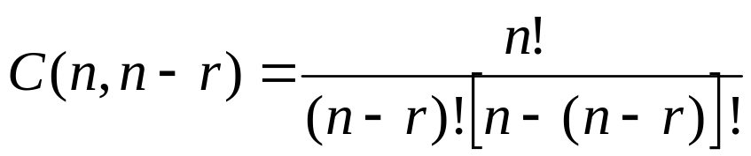
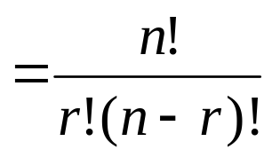
Review: corollary 1 from section 4.3
Let n and r be non-negative integers with
r ≤ n. Then C(n,r) = C(n,n-r)
Or,
Proof (from last slide set):

Slide 4
Review: combinatorial proof
A combinatorial proof is a proof that uses counting arguments to prove a theorem, rather than some other method such as algebraic techniques
Essentially, show that both sides of the proof manage to count the same objects
  Usually in the form of an English explanation with supporting formulae

Slide 5

Polynomial expansion
Consider (x+y)³:
Rephrase it as:
When choosing x twice and y once, there are C(3,2) = C(3,1) = 3 ways to choose where the x comes from
When choosing x once and y twice, there are C(3,2) = C(3,1) = 3 ways to choose where the y comes from

Slide 6
Polynomial expansion
Consider
To obtain the x⁵ term
  Each time you multiple by (x+y), you select the x
  Thus, of the 5 choices, you choose x 5 times
    C(5,5) = 1
  Alternatively, you choose y 0 times
    C(5,0) = 1
To obtain the x⁴y term
  Four of the times you multiply by (x+y), you select the x
    The other time you select the y
  Thus, of the 5 choices, you choose x 4 times
    C(5,4) = 5
  Alternatively, you choose y 1 time
    C(5,1) = 5
To obtain the x³y² term
  C(5,3) = C(5,2) = 10
Etc…

Slide 7
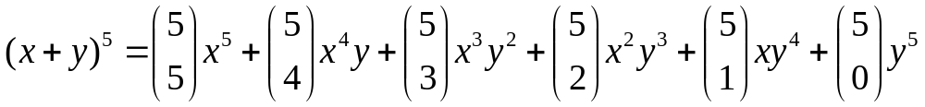
Polynomial expansion
For (x+y)⁵

Slide 8
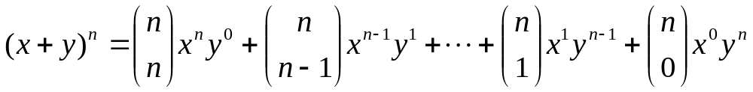
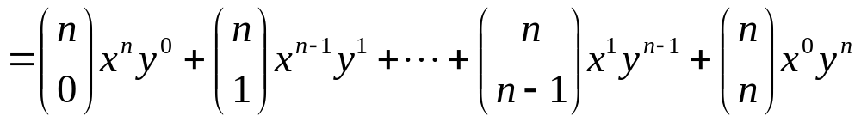
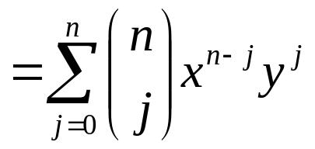
Polynomial expansion:
The binomial theorem
For (x+y)^{n}
The book calls this Theorem 1

Slide 9
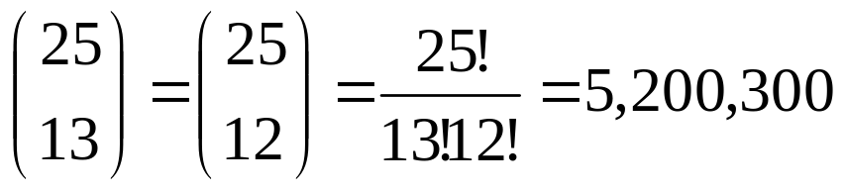
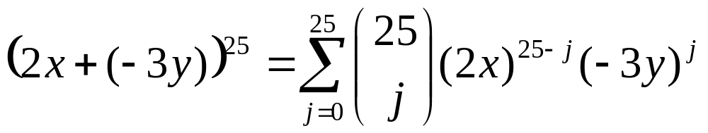
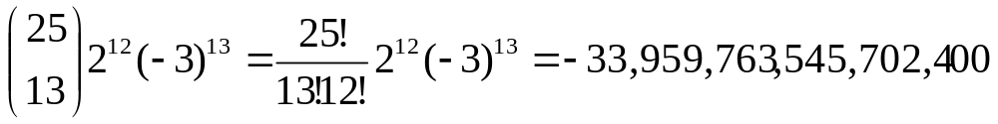
Examples
What is the coefficient of x¹²y¹³ in (x+y)²⁵?
What is the coefficient of x¹²y¹³ in (2x-3y)²⁵?
  Rephrase it as (2x+(-3y))²⁵
  The coefficient occurs when j=13:

Slide 10
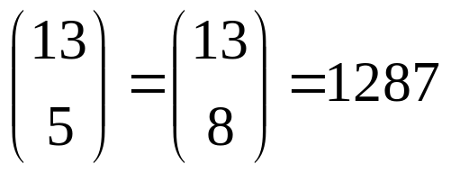
Rosen, section 4.4, question 4
Find the coefficient of x⁵y⁸ in (x+y)¹³
Answer:

Slide 11
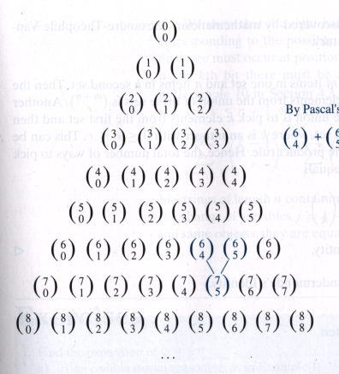
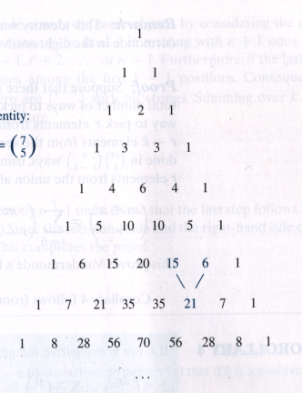
Pascal’s triangle
0
1
2
3
4
5
6
7
8
n =

Slide 12
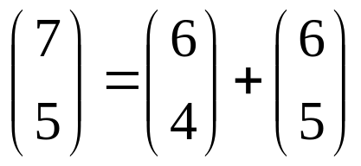
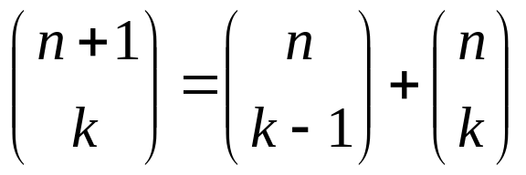
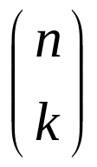
Pascal’s Identity
By Pascal’s identity: or 21=15+6
Let n and k be positive integers with n ≥ k.
Then
  or C(n+1,k) = C(n,k-1) + C(n,k)
The book calls this Theorem 2
We will prove this via two ways:
  Combinatorial proof
  Using the formula for

Slide 13
Combinatorial proof of Pascal’s identity
Prove C(n+1,k) = C(n,k-1) + C(n,k)
Consider a set T of n+1 elements
  We want to choose a subset of k elements
  We will count the number of subsets of k elements via 2 methods
Method 1: There are C(n+1,k) ways to choose such a subset
Method 2: Let a be an element of set T
Two cases
  a is in such a subset
    There are C(n,k-1) ways to choose such a subset
  a is not in such a subset
    There are C(n,k) ways to choose such a subset
Thus, there are C(n,k-1) + C(n,k) ways to choose a subset of k elements
Therefore, C(n+1,k) = C(n,k-1) + C(n,k)

Slide 14

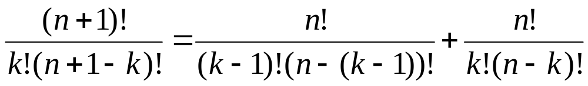
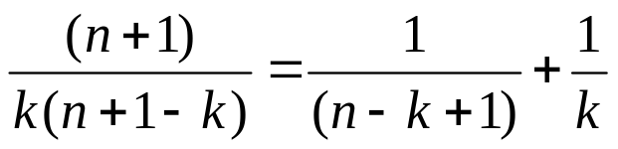
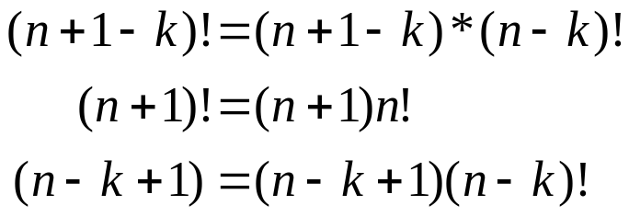
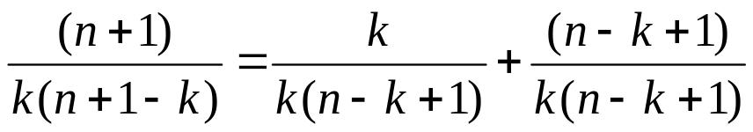


Rosen, section 4.4, question 19: algebraic proof of Pascal’s identity
Substitutions:

